Slide 1
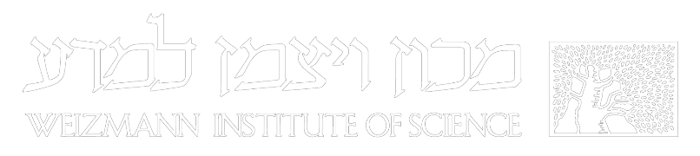
A superconducting magnetic trap for cold particles
Yair Segev
Ed Narevicius group
MICE conference 2019

Slide 2
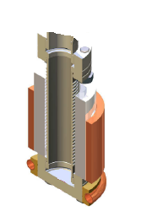
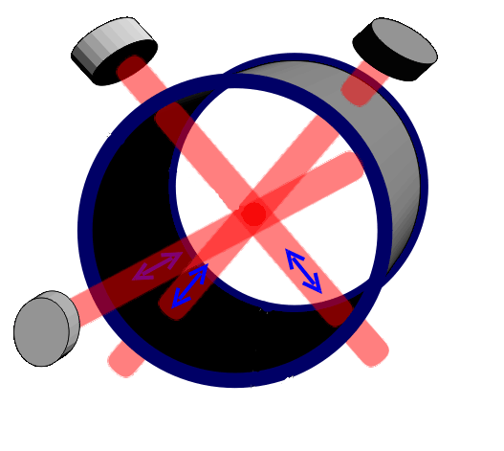
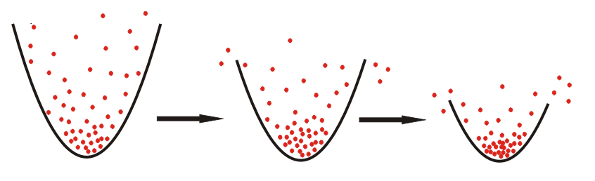
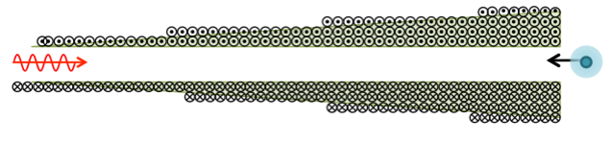
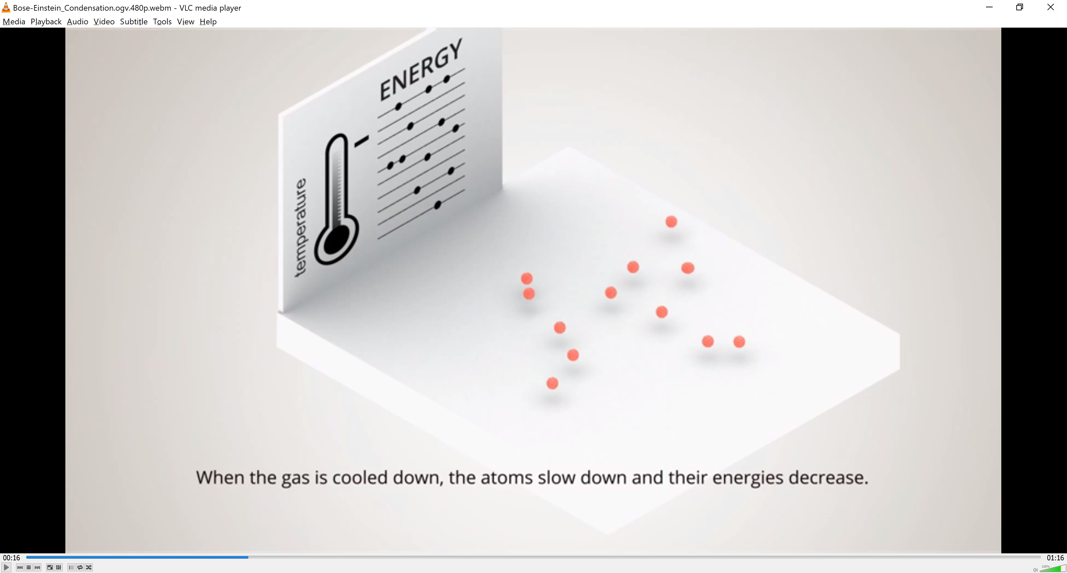
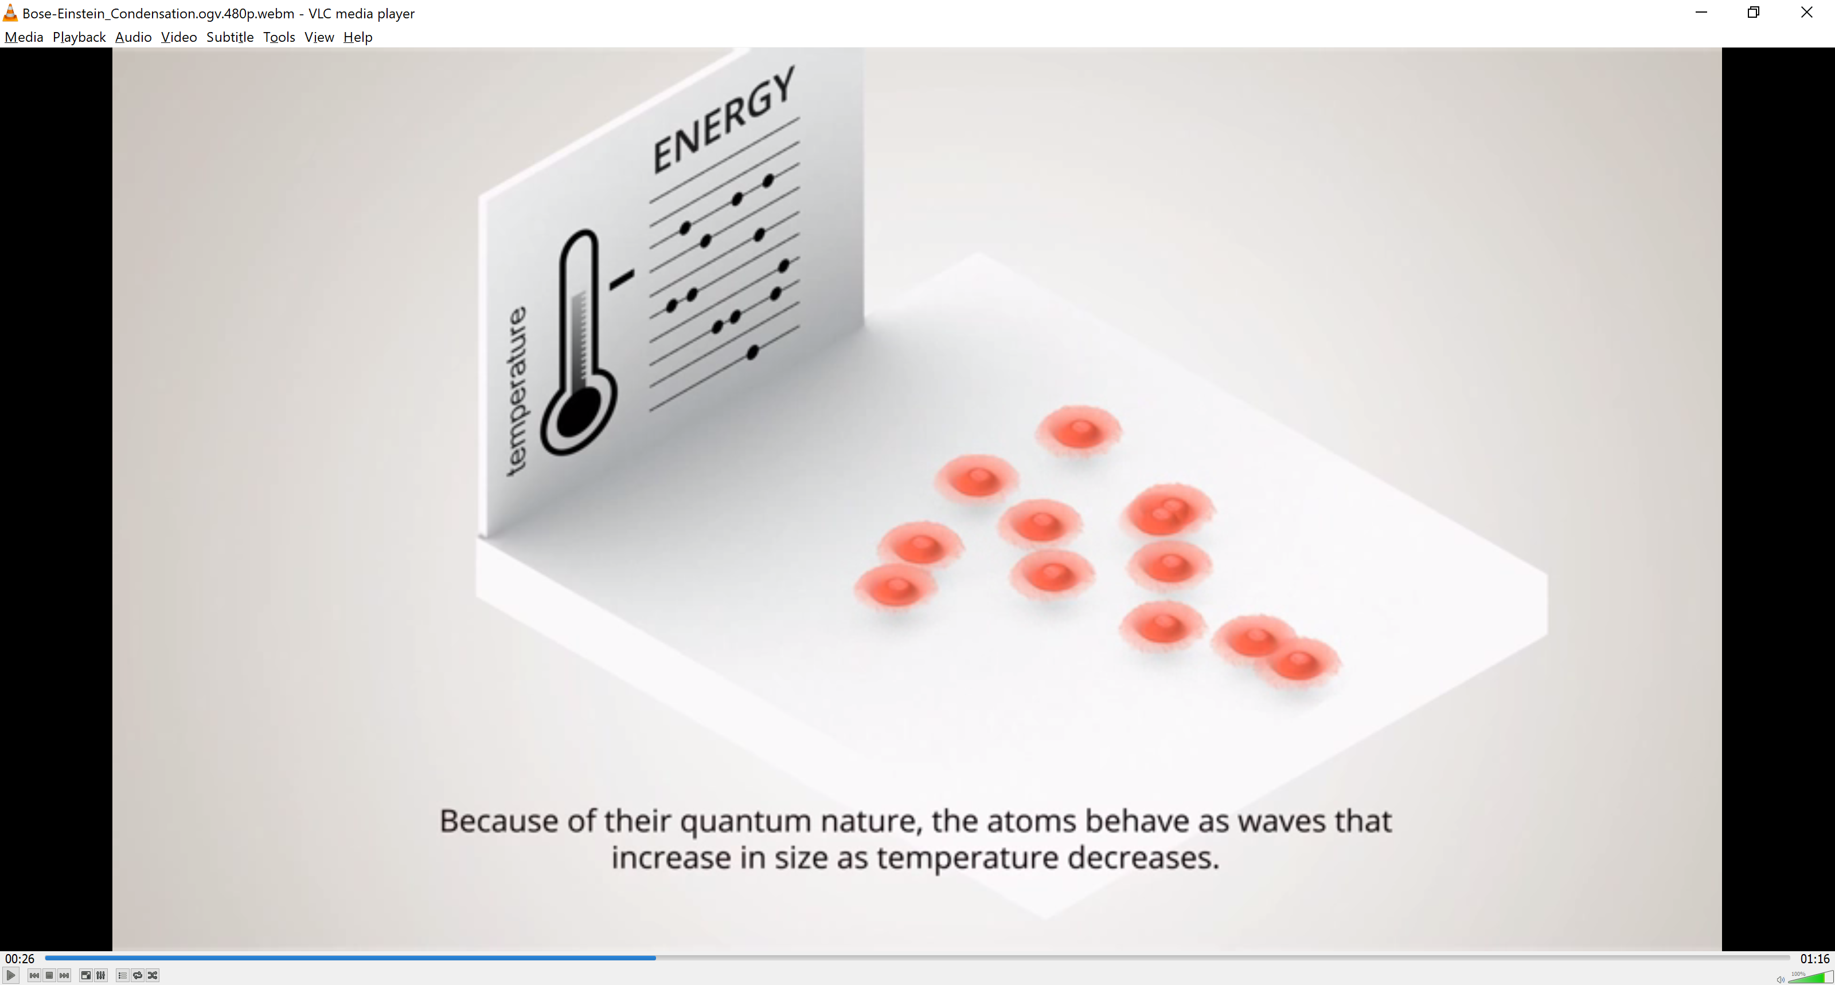
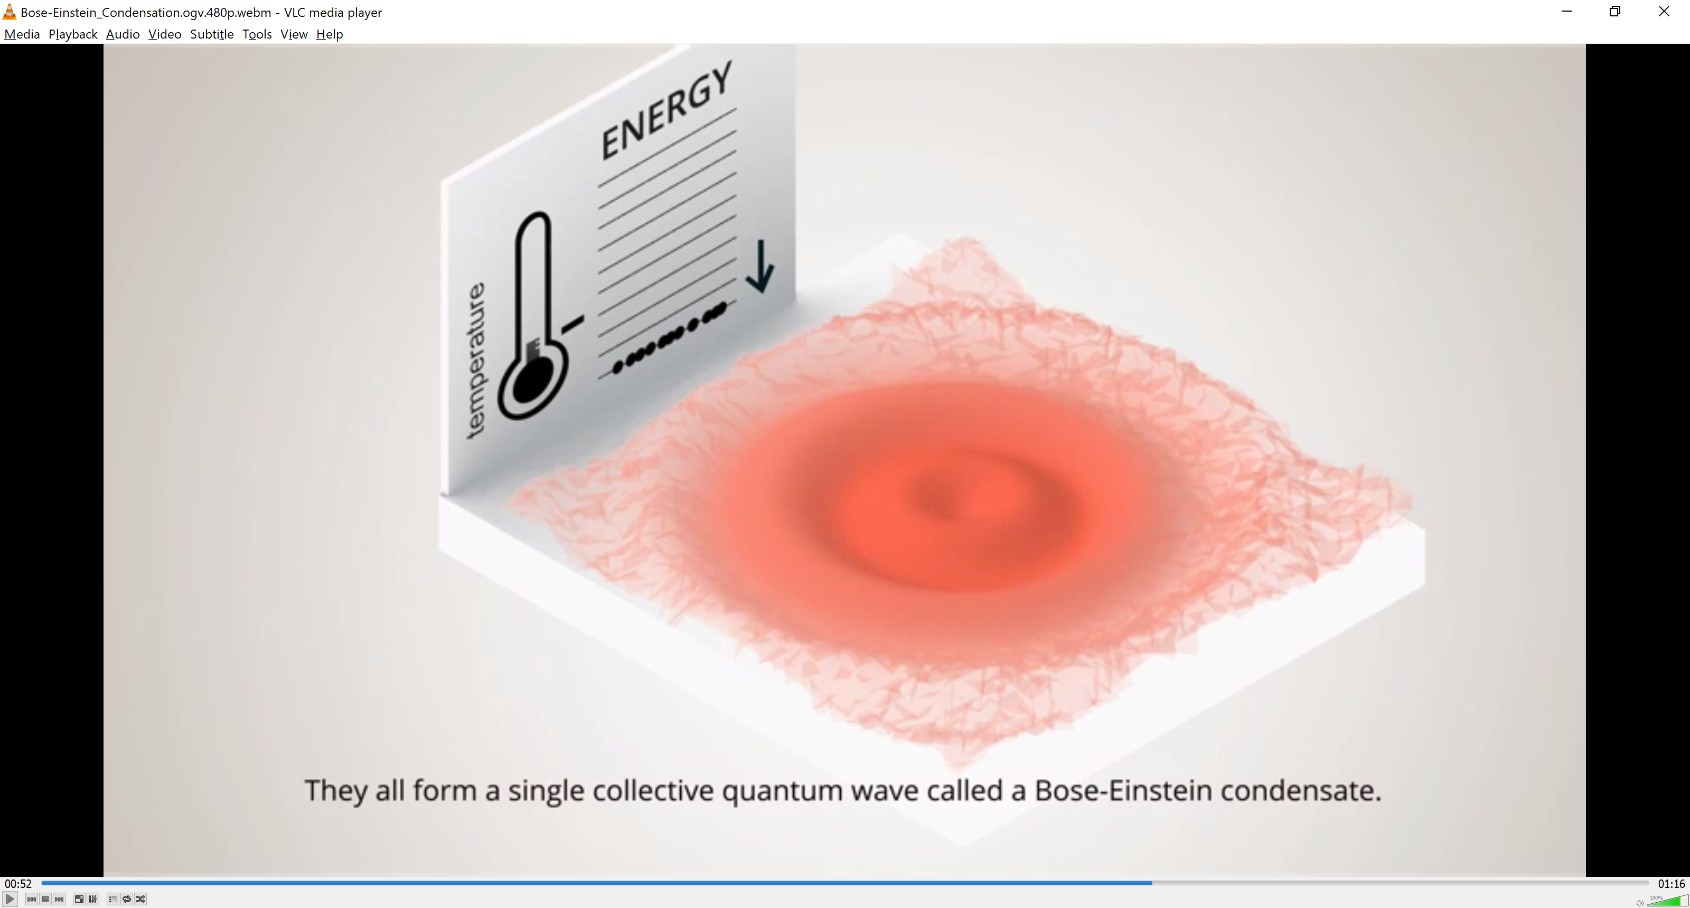
Cooling to the Ultracold
Oven source
Zeeman (optical)
slowing
Trapping & laser cooling
Evaporative cooling
Warm
Cold
Ultracold
Notes:
This is a typical BEC scheme for atoms, though there are many variations nowadays.
You start by emitting hot atoms from some effusive source, such as an over. If they are light and fast you slow them down by scattering photons in a Zeeman slower, and trap them using some configuration of magnetic, electric or optical fields. Here you cool them to, say, a millikelvin. Finally, if your density is sufficient and you’re lucky enough that your elastic collision rate is high enough, you gradually evaporate the hotter portions out of your trap and remain with a condensate.
This works great for many atom species. Unfortunately, with most molecules optical cooling (and slowing) or not really an option, ad the chances of scattering many thousands of photons without falling into a different “dark” rovibrational state is very poor. Some of our brave colleagues and competitors such as Jun Ye, Dave DeMille and Mike Tarbott are doing exactly that with some of the few known molecules that do have a chance of this, but there remains a risk that these species will not have the characteristics required for evaporation.
We envision a method which can be applicable to many molecular species. So, we will avoid direct laser cooling or slowing.
The main components, all three of which I will talk about, are a source – a supersonic nozzle; an adiabatic slower which works on time-varying magnetic fields, and a deep magnetic trap for the final stages.

Slide 3
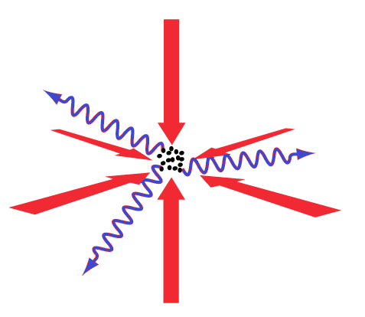
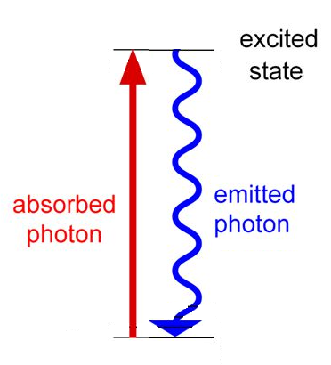
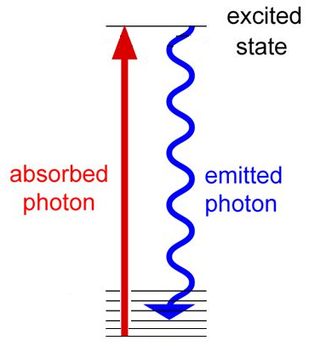
The challenge of cooling molecules
Simple atoms
Typical molecules
Candidate molecules:
SrF, YbF, CaF,
SrOH,
YO,
BaH
Assembly from laser cooled atoms:
KRb, Cs₂, NaK, NaLi, (Feshbach)
Sr₂… (photo-association)

Slide 4
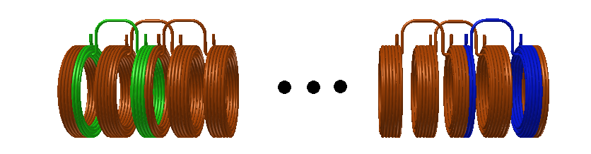
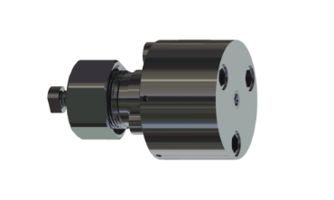
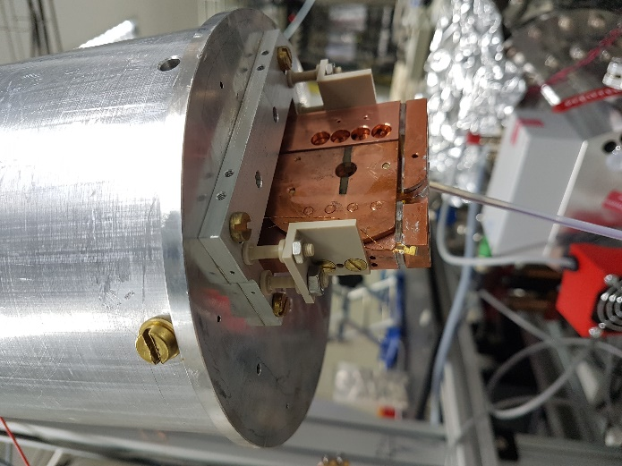
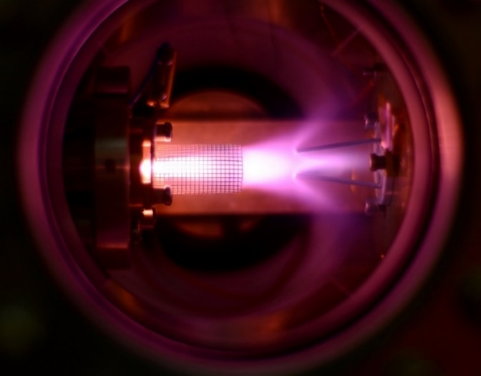
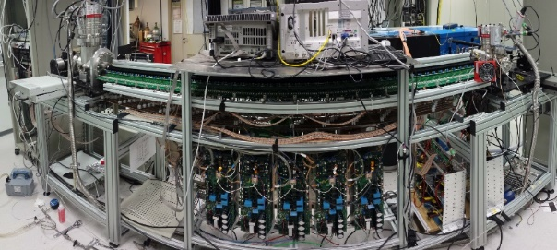
Masterplan for cooling (paramagnetic) molecules
Expansion cooling
Magnetic slowing
Evaporation

Slide 5

Masterplan for cooling (paramagnetic) molecules
Step 1: Expansion cooling

Slide 6
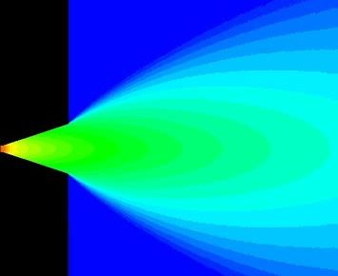

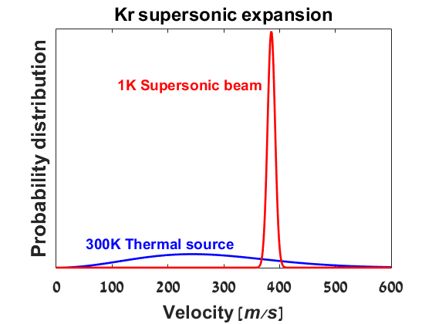
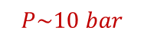
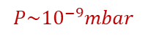
Supersonic expansion cooling
Vacuum
chamber
$$P\sim {10}^{−9}mbar$$
Gas source
chamber
$$P\sim 10 bar$$
Simple and general
High densities (~10¹⁵ cm⁻³)
Low temperatures (<1K)
Notes:
We’ll start briefly with the source. Supersonic expansion is a fancy name for letting a stagnant gas out into vacuum. If the source pressure is sufficiently high, collisions between particles as they pass through a nozzle will lead to a narrow velocity distribution, on the order of 1K. Here is a typical velocity distribution within a nozzle, and the final distribution in vaccuum. The method is simple, general,…
Our valves, designed by Uzi Even of Tel Aviv, shoot 10^16 particles in pulses of tens of microseconds, so their momentary flux of cold molecules is very high compared to CW beams, themselves much higher than effusive sources.

Slide 7

Masterplan for cooling molecules
Step 2: Magnetic slowing

Slide 8
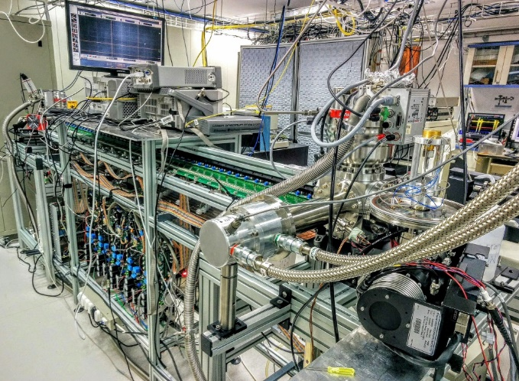
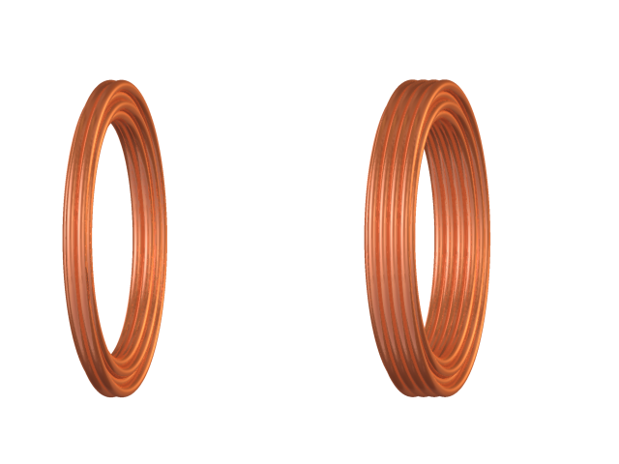
Adiabatic magnetic deceleration
High initial beam velocities:
300-2000 m/s
Goal:
Slow beam to trappable velocity without significant heating or density loss
Magnetic Field Magnitude
Distance

Slide 9
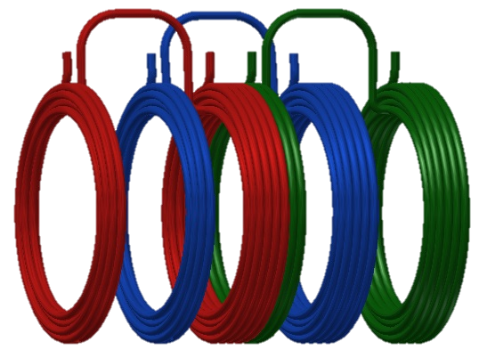
Adiabatic magnetic deceleration
Trap 1
Trap 2
Trap 3
Magnetic Field Magnitude
Propagation axis
Current
Δt₁ < Δt₂
Distance
t
Notes:
Overlap between the pulses must be increased, by making the pulse duration and the pulse-to pulse time difference longer .

Slide 10


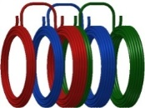
Actual setup
Source chamber
Detection
chamber
Overlapping traps
Switching electronics
480 overlapping traps
Pulsed currents ~ 500A
See poster by Michael Karpov
Deceleration of
a ~ -3000 g
3 meters long
I
t
Notes:
NOT BENT!

Slide 11
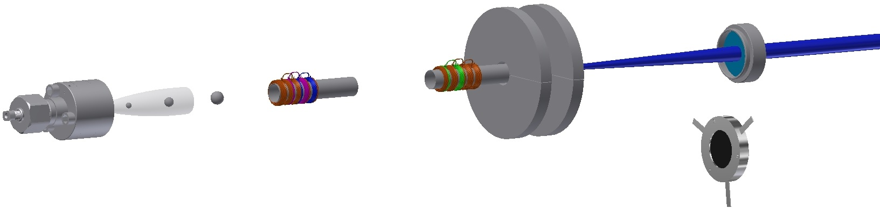
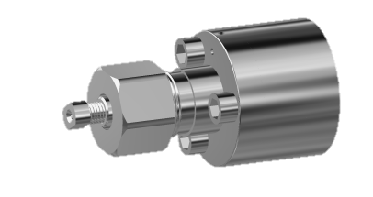
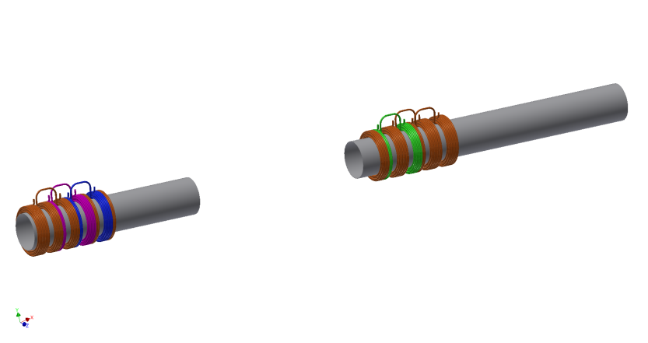
Trapping
Permanent magnets trap
Ionization via REMPI
Ion
extraction
B
Ion counter
N. Akerman et al, PRL 2017

Slide 12
Trapping
For collisions, we want:
Longer trapping lifetime
Tunable trapping
gradient (~1T/mm)
We need better magnets
N. Akerman et al, PRL 2017

Slide 13
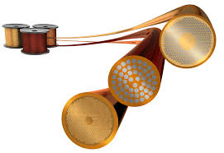
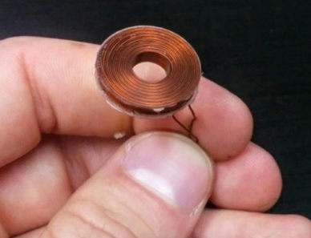
Superconducting coils
L_{[ow]} T_{[emperature]} S_{[uperconductors]}
T_{c}<20K
Metal alloy wires (flexible)
Need to switch 1T field in
500 microseconds
Poor AC response = quench

Slide 14
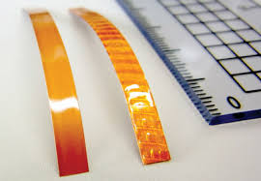
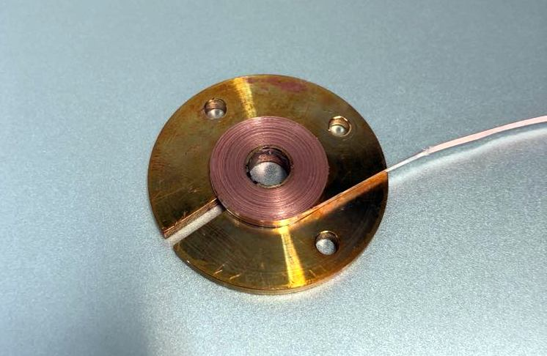
Superconducting coils
L_{[ow]} T_{[emperature]} S_{[uperconductors]}
T_{c}<20K
Metal alloy wires (flexible)
Poor AC response
H_{[igh]} TS
T_{c}>77K
Cuprate ceramic tapes (fragile)
Robust (pulsing, temperature)

Slide 15
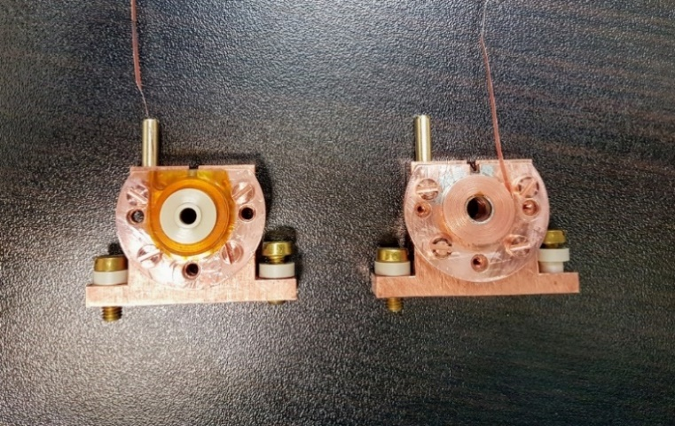
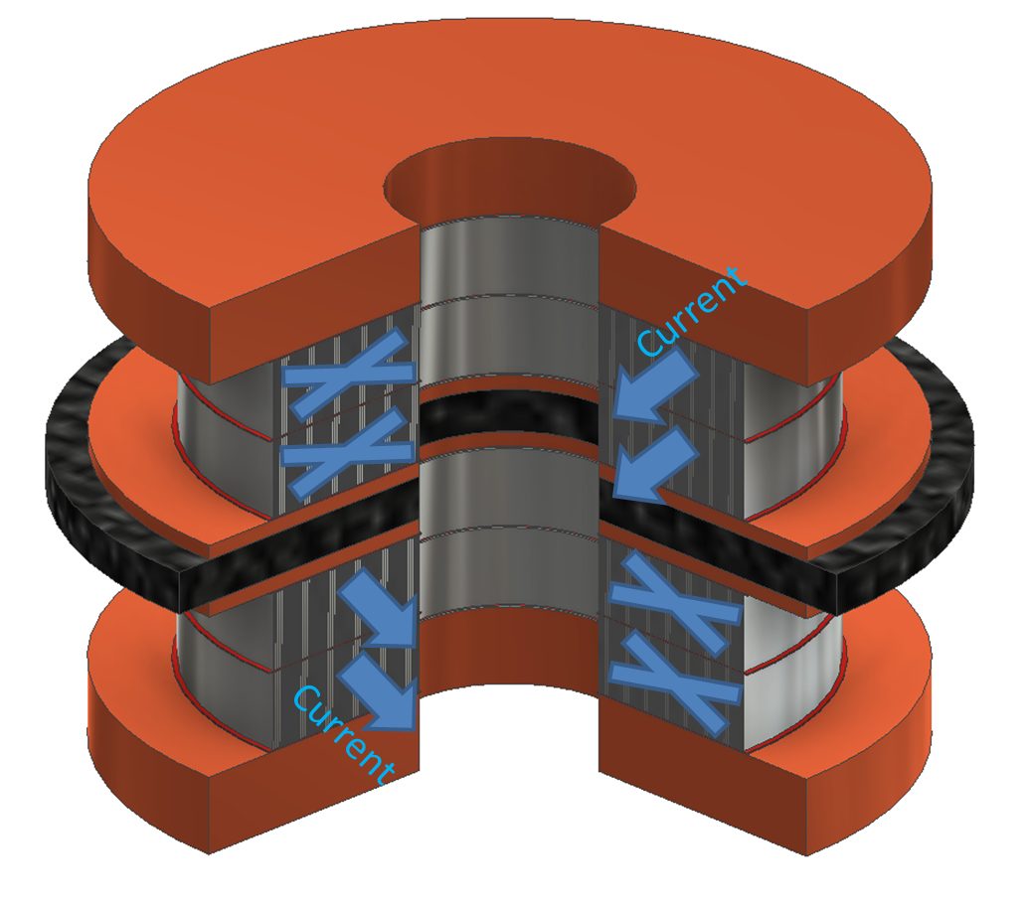
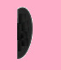
Superconducting trap
Notes:
To create high magnetic field gradients in our tiny trap requires a current density of hundreds of A/mm^2, 1-2 orders of magnitude above the rating of a relevant Cu wire. So we chose to build a trap using a superconducting wire which wind into coils that can carry 1000A/mm^2. This is the bare coil, our very first one, and here we have glued it to sapphire holders. The trap will be two such coils with countercurrents, with a ferromagnetic disc between them. BTW, Using such a coil has a nice advantageous side-effect: the wire is a Low TC superconductor (NbTi), so we use a 4K pulse-tube cryostat to keep it superconducting. This cryostat also improves our vacuum by 2 orders of magnitude, which should give us the lifetime we need.

Slide 16
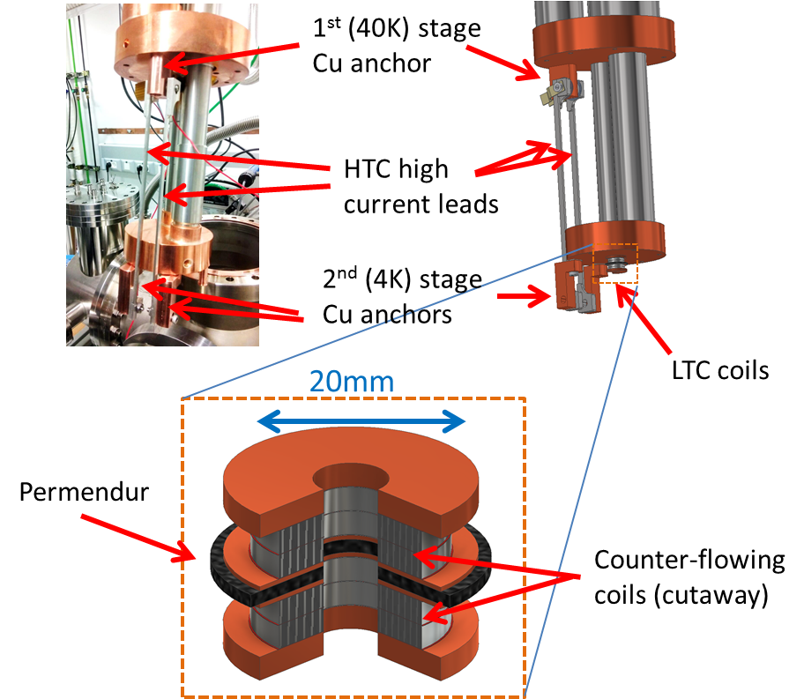
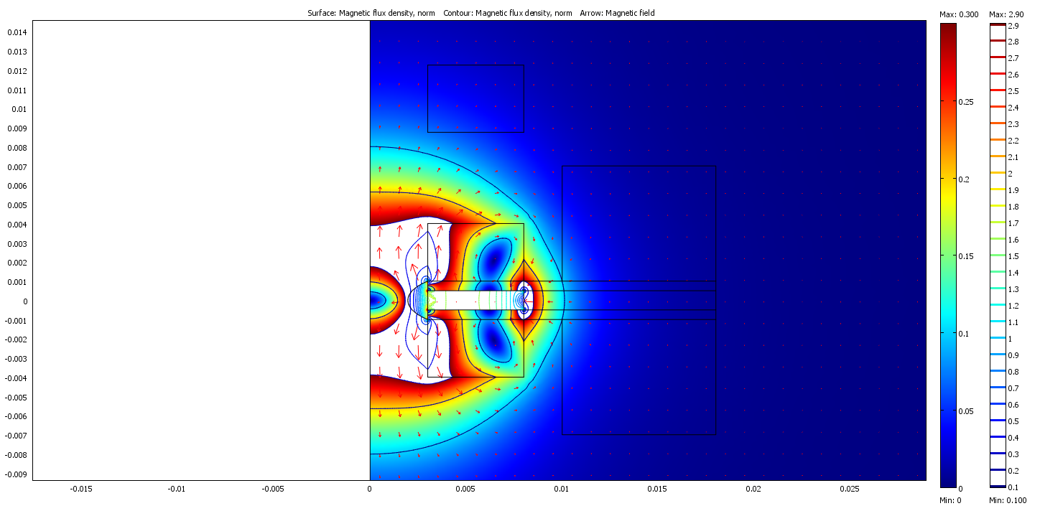
Superconducting trap
Trapping (30A)
Notes:
So what can this trap give us? So running it at 10% of the superconductor’s critical current already gives us a trap of 0.5K that matches the decelerator’s traps – you see it here as the oval in the center of the coil.

Slide 17
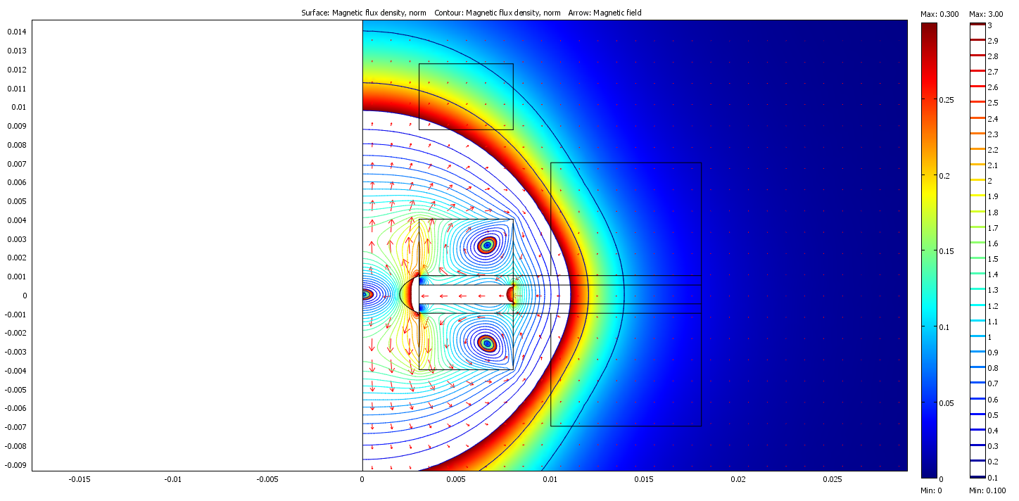
Superconducting trap
Compression (200A)
Gradient increase α=6
Collision rate increase α^{4/3}=10
Notes:
If we ramp it up the gradient increases by a factor of 6 or so. This means that the density is increased, and more importantly, the collision frequency is increased by an order of magnitude, and should now be on the order of tens of Hz, well within even our current lifetime.

Slide 18
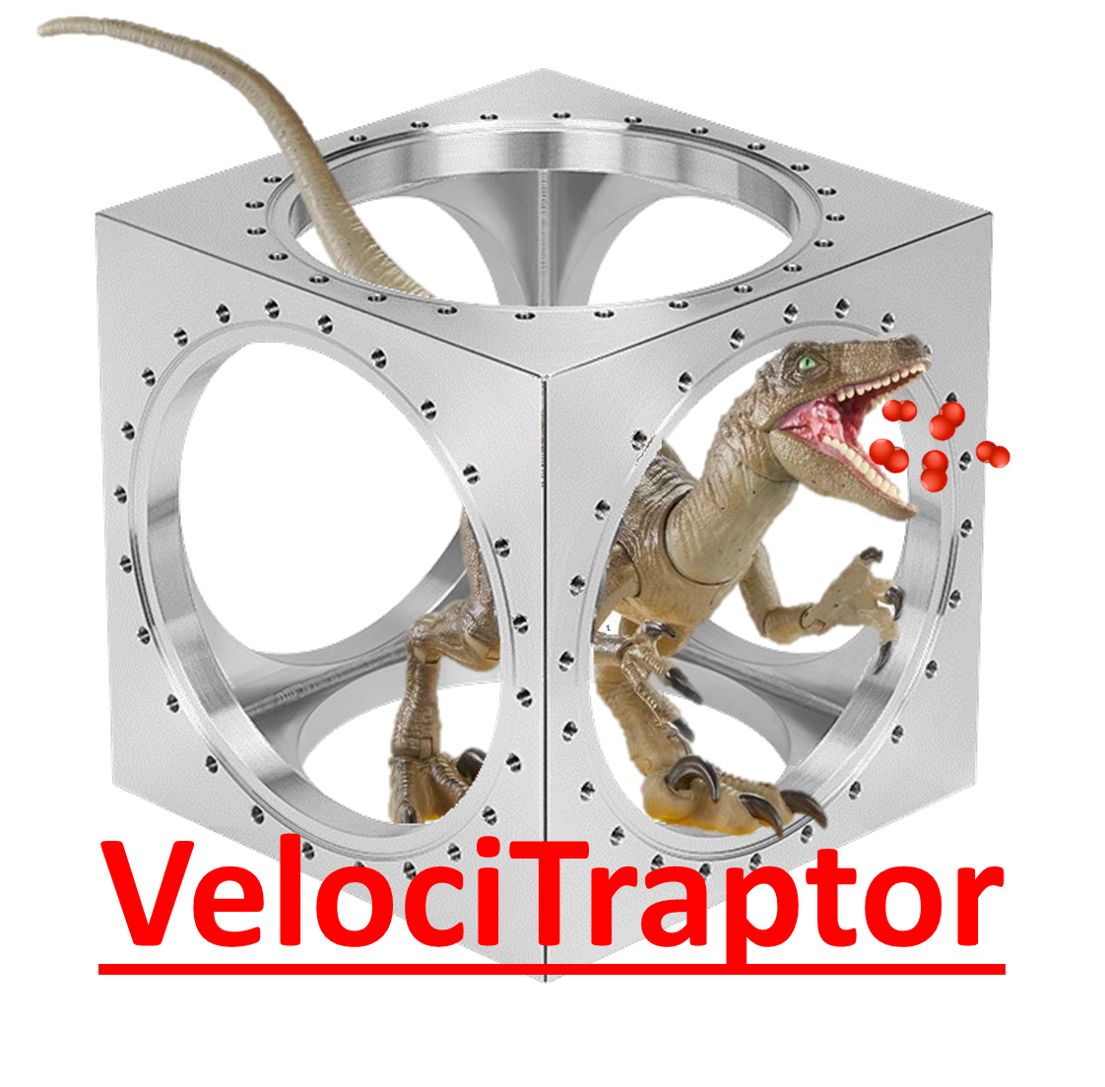
Superconducting trap
Compression (200A)
Gradient increase α=6
Collision rate increase α^{4/3}=10
Notes:
If we ramp it up the gradient increases by a factor of 6 or so. This means that the density is increased, and more importantly, the collision frequency is increased by an order of magnitude, and should now be on the order of tens of Hz, well within even our current lifetime.

Slide 19
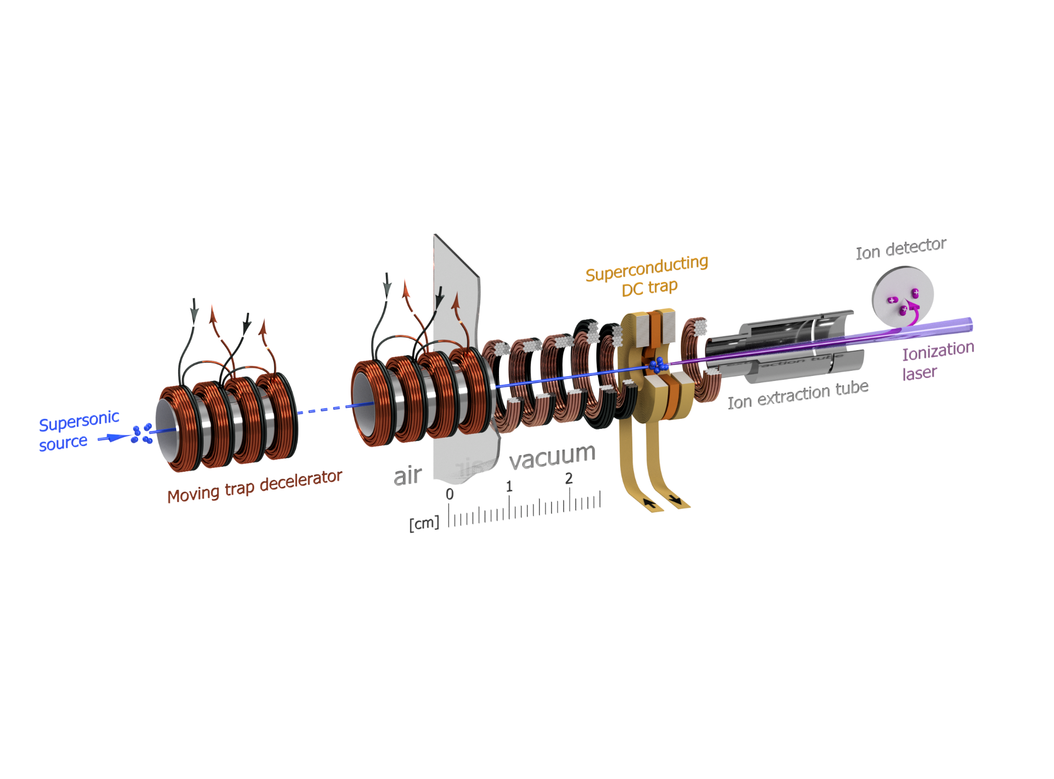
Integration with decelerator
40 K
15 K
300 K

Slide 20
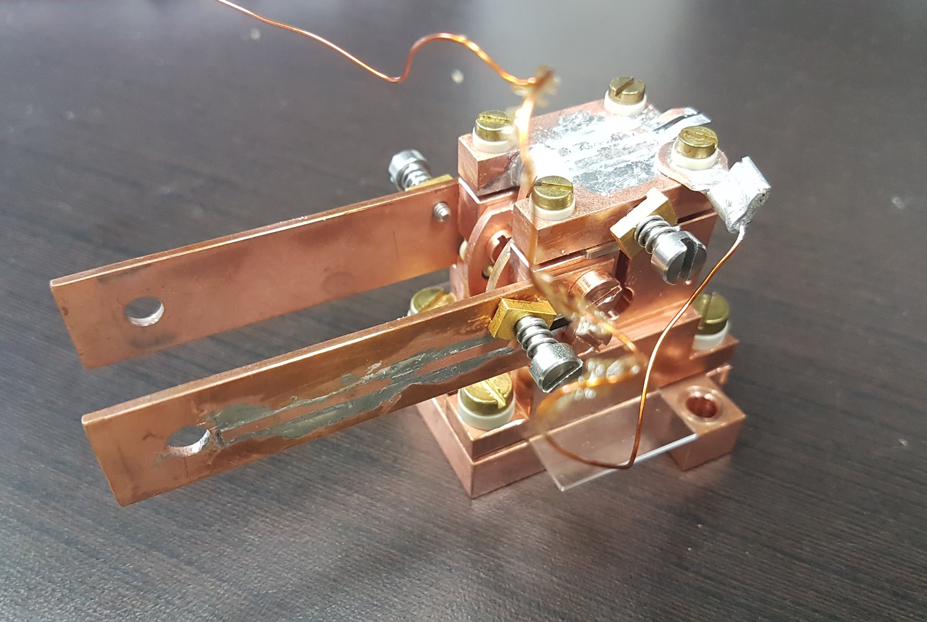
Challenge 1: Miniaturization

Slide 21
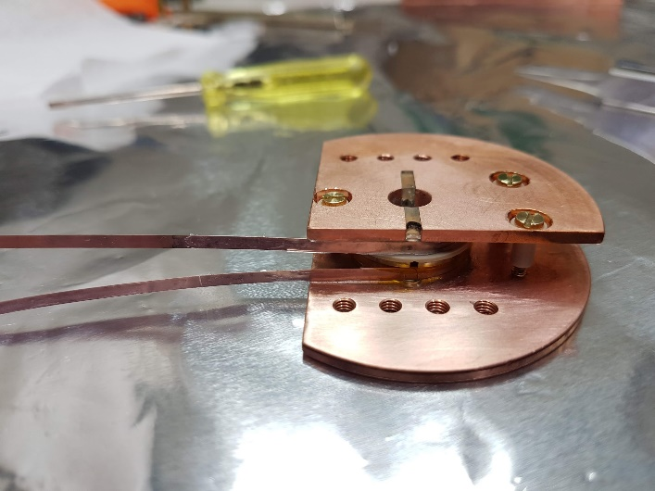
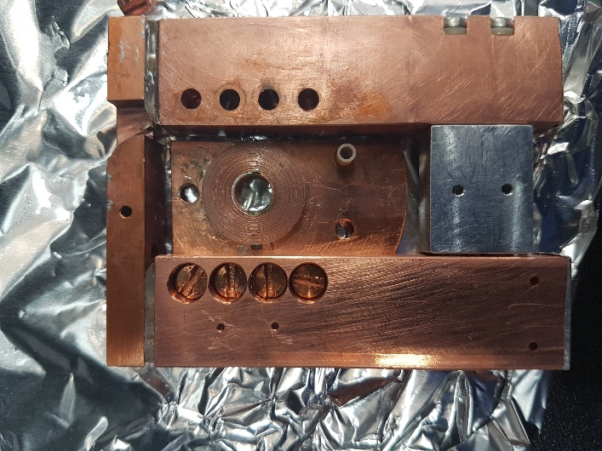


Slide 22
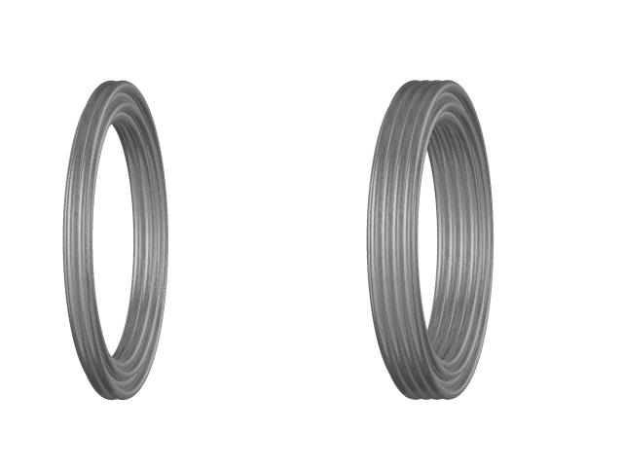
Challenge 2: Current kicking & flipping

Slide 27
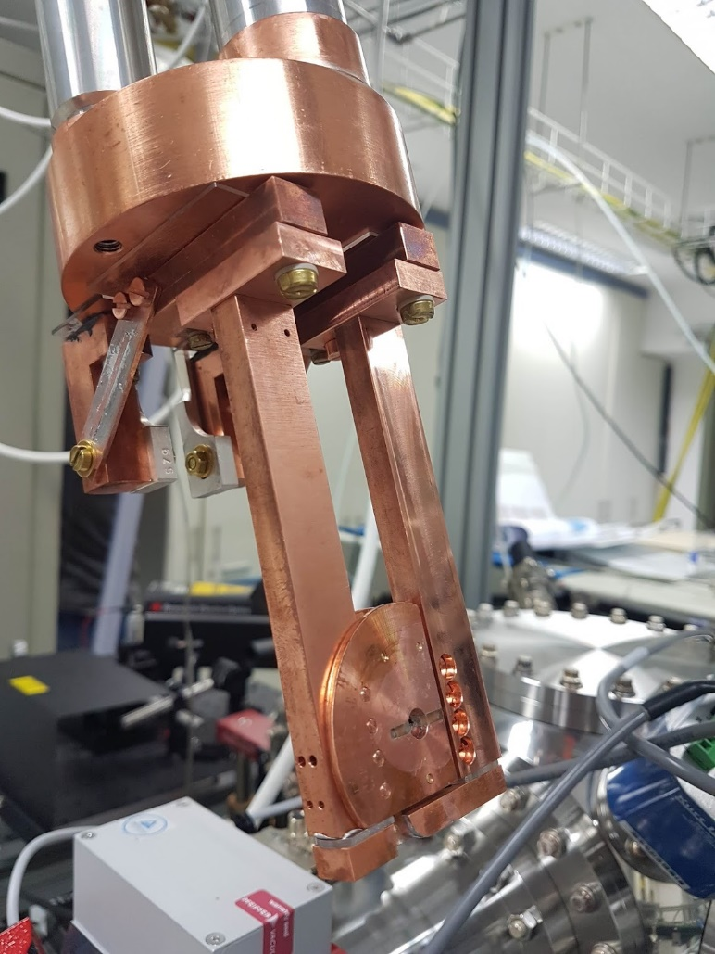
Challenge 3: Thermal contraction & warping

Slide 28
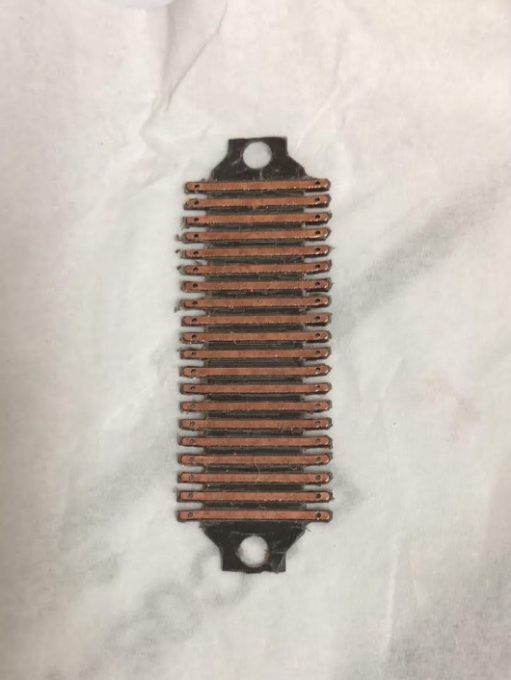
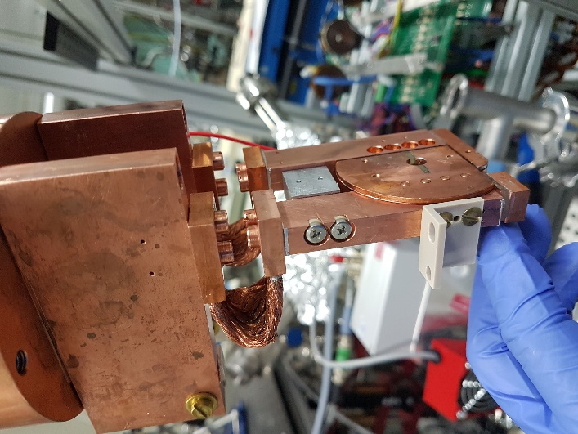
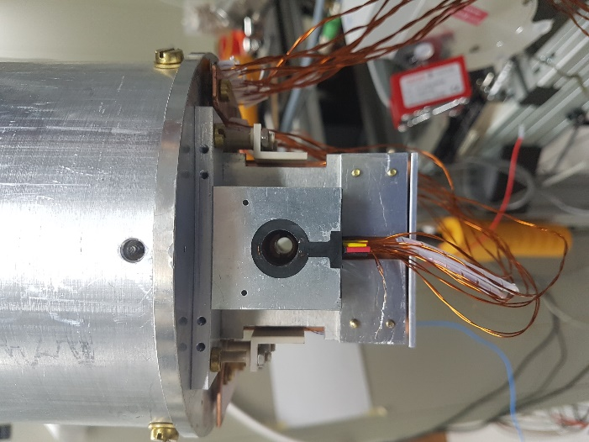
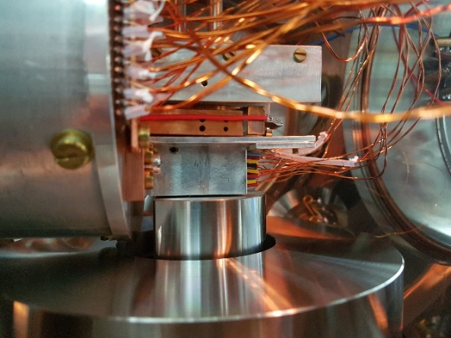
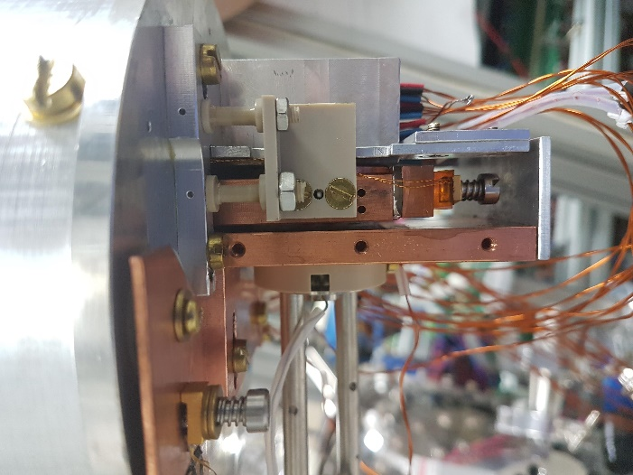
UHV-compatible PCB
300K
40K
15K

Slide 29
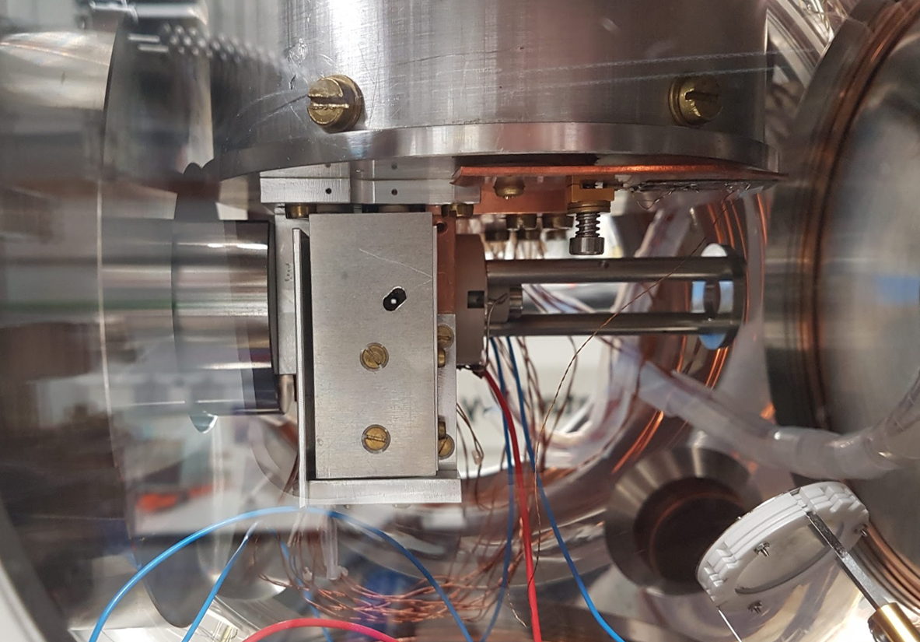
VelociTraptor assembled!

Slide 30




Supervisor
Ninja
4K Cryocooler
Decelerated molecules
Detection laser
Trap center
PhD student

Slide 31


Results
0.01s
1s
3s
5s
dn/dt~-n
Significant amount of O₂ trapped for >90s!

Slide 32
Results
First direct observation of cold bimolecular collisions in a trap, without laser cooling
Yair Segev*, Martin Pitzer*, Michael Karpov* et al.
Nature, 2019
dn/dt~-n²

Slide 33




Lithium and oxygen mixture

Slide 34
Masterplan for cooling (paramagnetic) molecules
Expansion cooling
Magnetic slowing
Evaporation

Slide 35
Evaporative cooling in a magnetic trap
Energy distribution
Good: elastic collisions
Bad: inelastic collisions, background collisions

Slide 36

Slicing the trap
good/bad~ 6
☹

Slide 37
Cross-sections and losses
τ_{2B} @ edge / τ_{2B} @ center
good/bad~ 6
~ Uniform decay
→ Inelastic losses dominate
Decay faster at edge
→ Evaporative losses dominate
σ_{elastic} / σ_{inelastic}

Slide 38
What’s next?
It works!
Load superconducting trap
(If that works…)
Measure collisions
(If the elastic/in-elastic ratio is favorable…)
Evaporate
We did!
☹ … for ¹⁶O₂
Search for a better candidate: ¹⁷O₂, ¹⁶O¹⁸O, NH, NH₂, CH₃,…
Notes:
So where do we go from here?
…
I don’t know if I’ve convinced you that we will make a molecular BEC. Hell, there are days I’m skeptical. But what I really hoped to convince you is that we have a lot of fun and a lot of challenges. And the reason I emphasize this is because this is what a was man promised me when he convinced me to go to a PhD, when we met for a noce steak dinner in Argentina. And by now I’m sure that hyou can all guess who this man was..

Slide 39





Next Generation Decelerator
Other candidate gases: NH/NH₂
→ larger initial velocity
~ 3 m
~ 6 m

Slide 40



Julia Narevicius
Michael
Karpov
Ed
Narevicius
Martin
Pitzer
Nitzan
Akerman
Idan
Yair
Segev

